Slide 1


Slide 2
H2H CART
Group Number:- 9
Team Members:- Anusheel, Vinay Prajapat, Manikant Ojha, Sunvith Reddy, Parvez, Abhishek
Task:- To create social media accounts and website for our venture
Individual Tasks:- Facebook by Anusheel, LinkedIn by Abhishek, YouTube by Parvez, Instagram by Manikant, Website by Vinay and Blog by Sunvith.
Course Code:- ERT-245

Slide 3
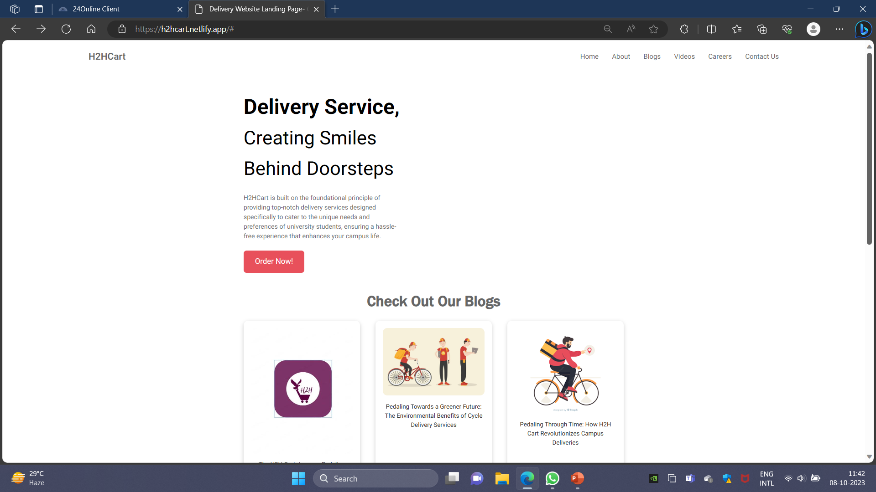
Website
Working link of the account:- http://h2hcart.netlify.app

Slide 4
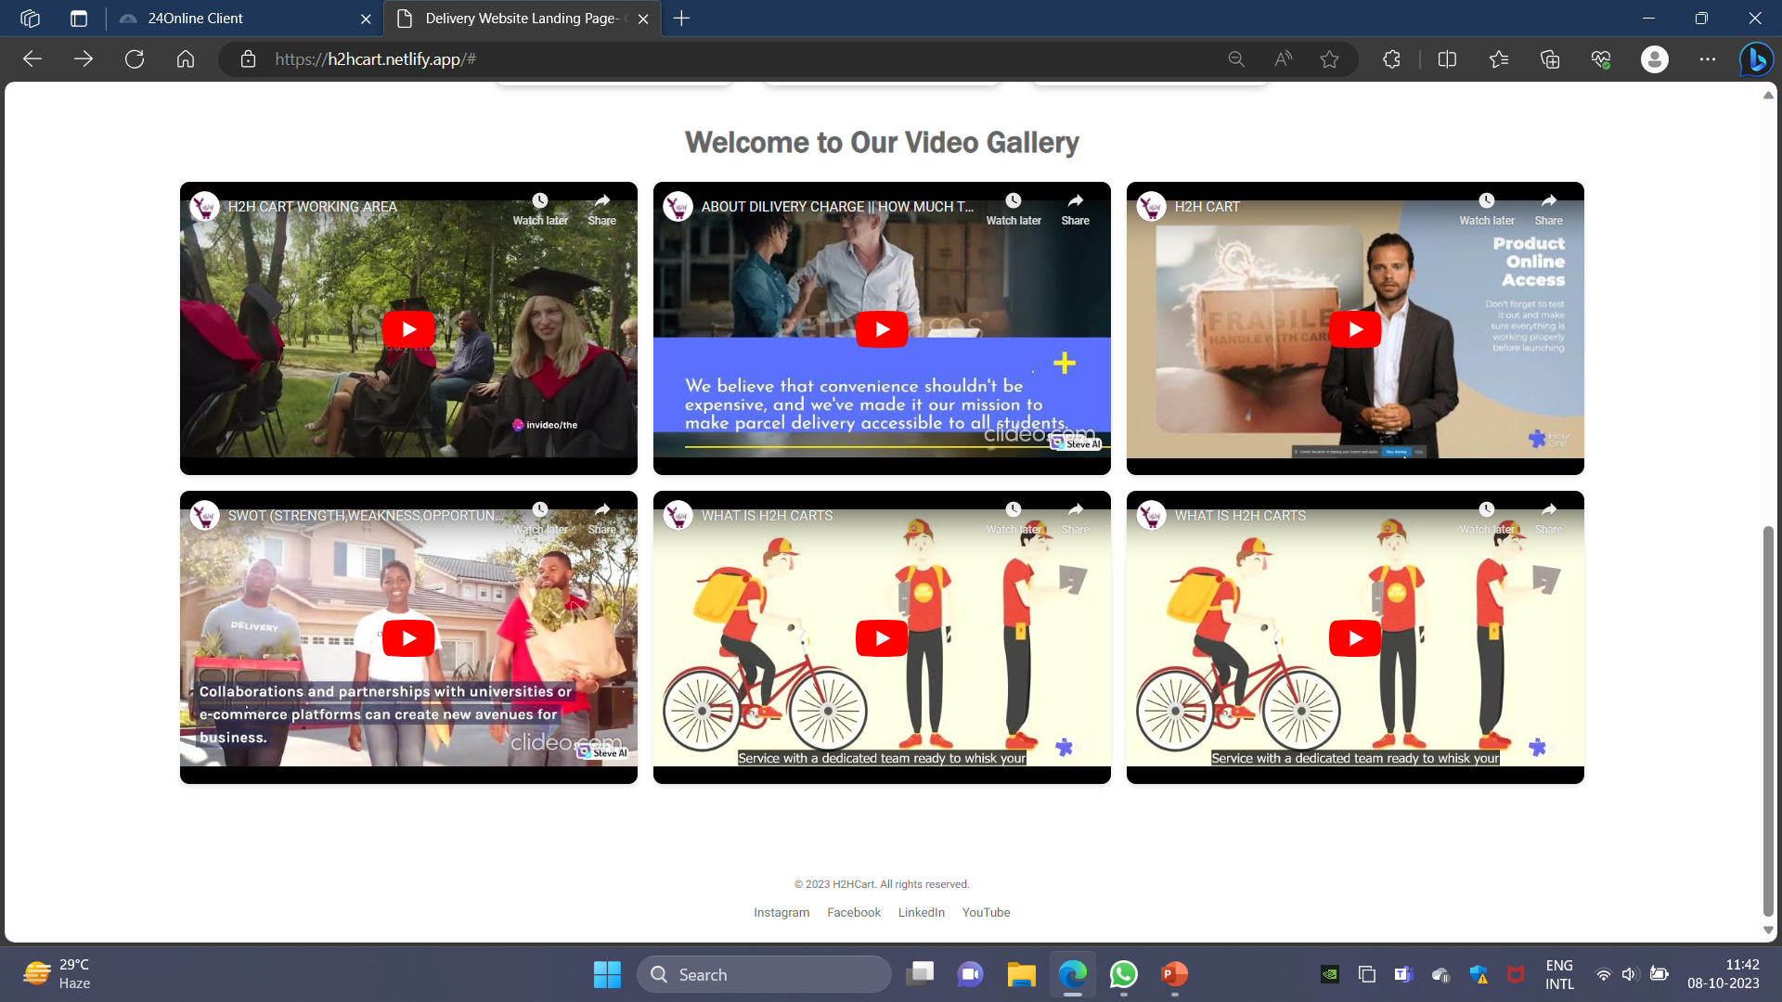

Slide 5
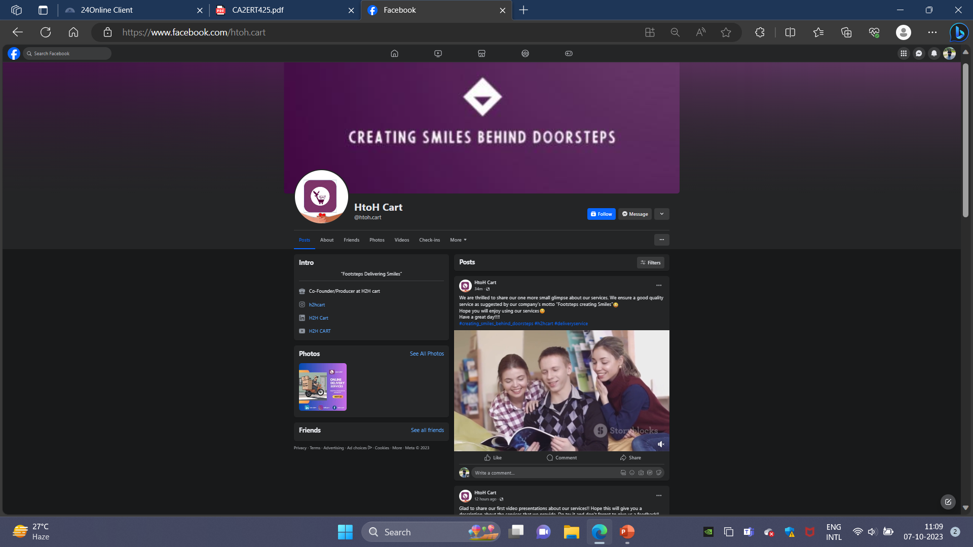
facebook
Working link of the account:- https://www.facebook.com/htoh.cart

Slide 6
Working Links for facebook posts
https://www.facebook.com/61552322360442/videos/823567996177631/
https://www.facebook.com/61552322360442/videos/351384327304704/
https://www.facebook.com/61552322360442/videos/3241700949462293/
https://www.facebook.com/photo/?fbid=122094124574077412&set=a.122094124634077412
https://www.facebook.com/61552322360442/posts/pfbid08tAjLyABGoHFLEHCQfDJkG8Trx52BowoiA6BzDpCWs3Ts9znME6r8f367kxBuTrDl/?mibextid=cr9u03
https://www.facebook.com/61552322360442/posts/pfbid0gYKQSRWyx7ycMt8XMr451semPrv7PGy6bieP2K6Uk6Deayt3mw6VzameRYJ5ZRCxl/?mibextid=cr9u03

Slide 7
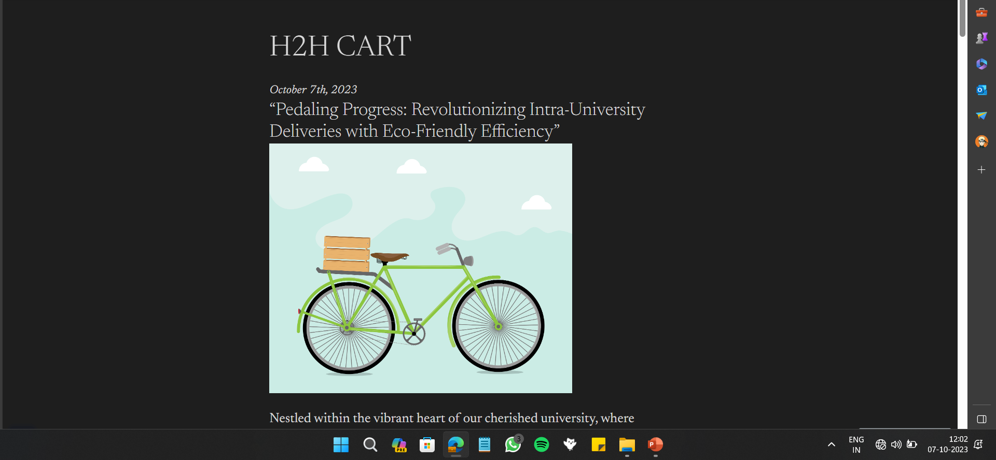
Blogs
Working link of the account:- :- https://wordpress.com/view/h2hcart.wordpress.com

Slide 8
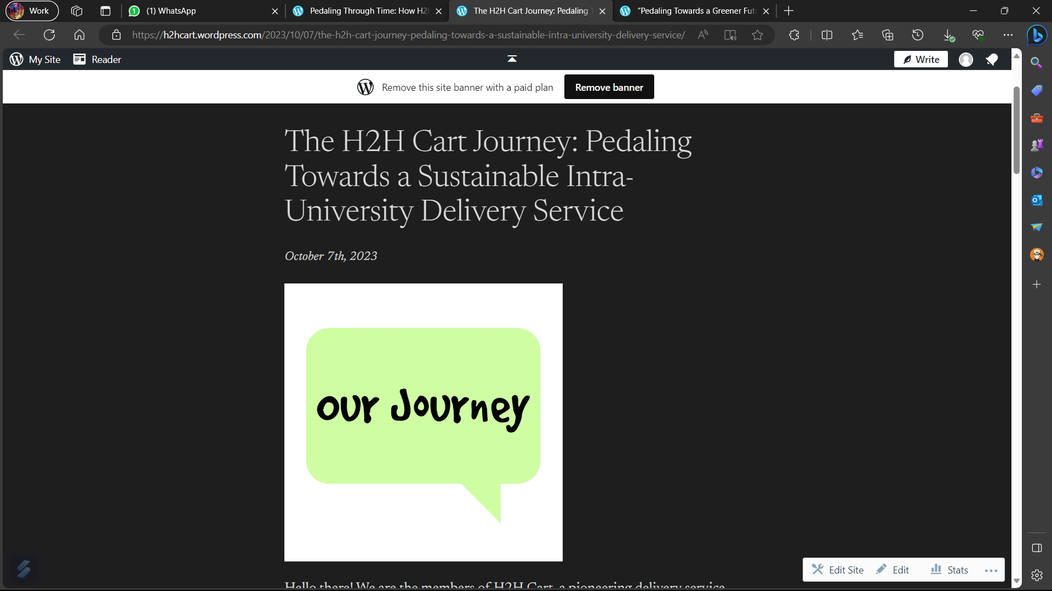

Slide 9
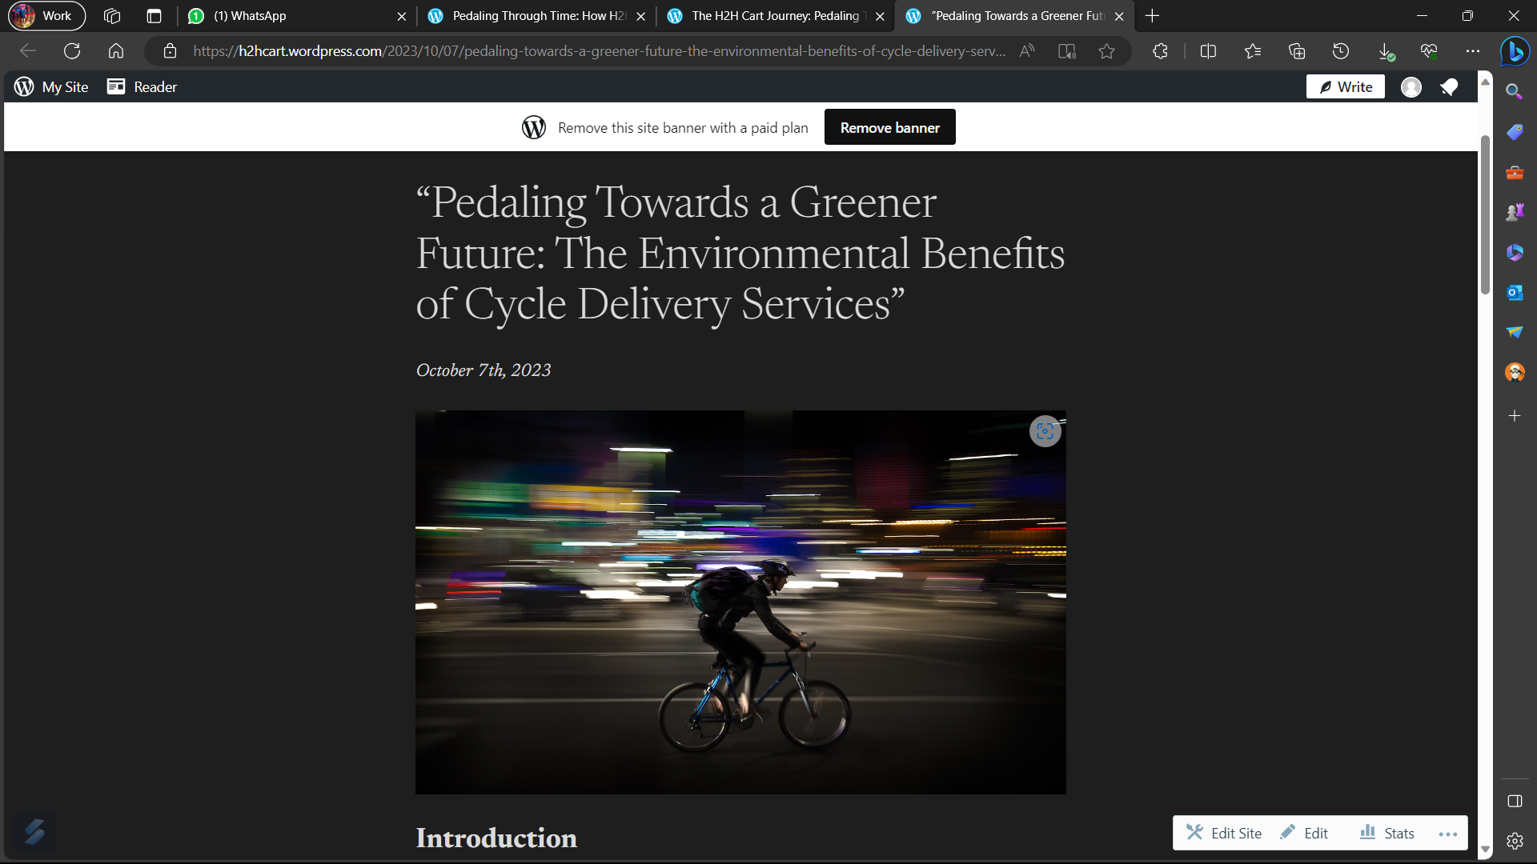
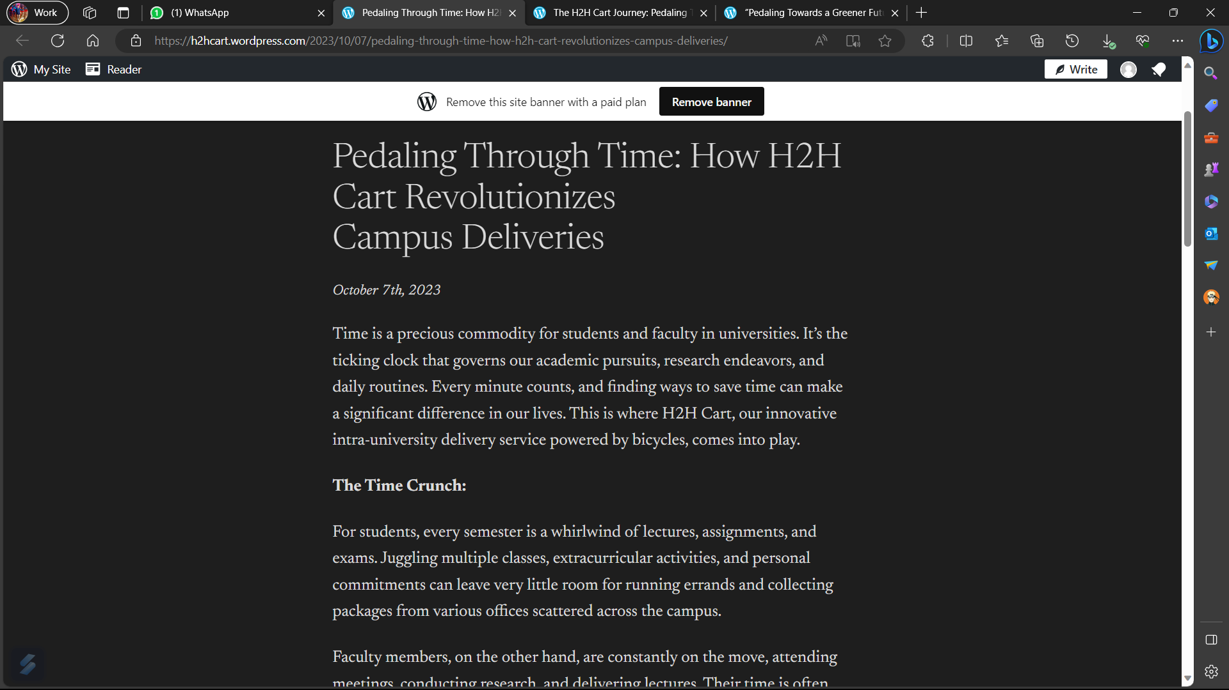

Slide 10
Working Links for Blogs
https://wordpress.com/view/h2hcart.wordpress.com
https://h2hcart.wordpress.com/2023/10/07/the-h2h-cart-journey-pedaling-towards-a-sustainable-intra-university-delivery-service/
https://h2hcart.wordpress.com/2023/10/07/pedaling-towards-a-greener-future-the-environmental-benefits-of-cycle-delivery-services/
https://h2hcart.wordpress.com/2023/10/07/pedaling-through-time-how-h2h-cart-revolutionizes-campus-deliveries/

Slide 11
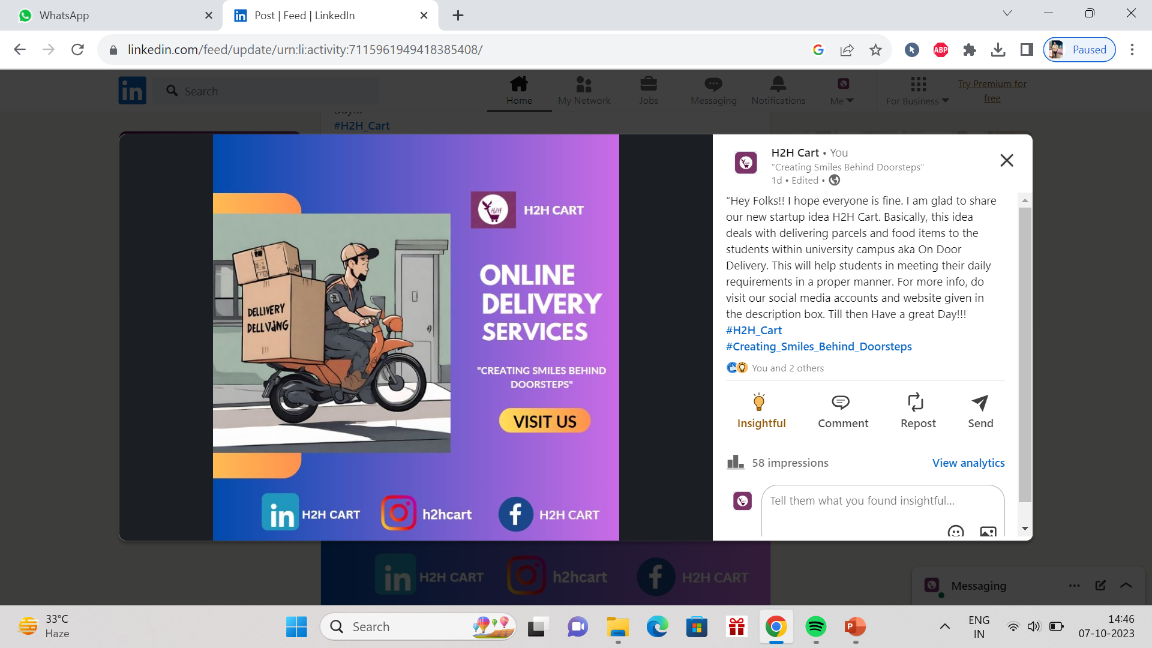
Linked in
Working link of the account:- https://www.linkedin.com/in/h2h-cart-48577a294/

Slide 12
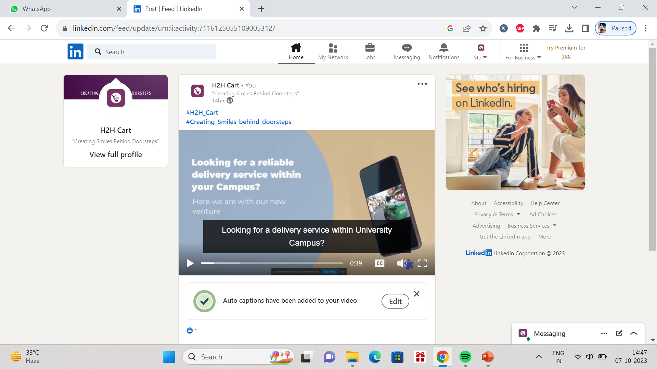

Slide 13
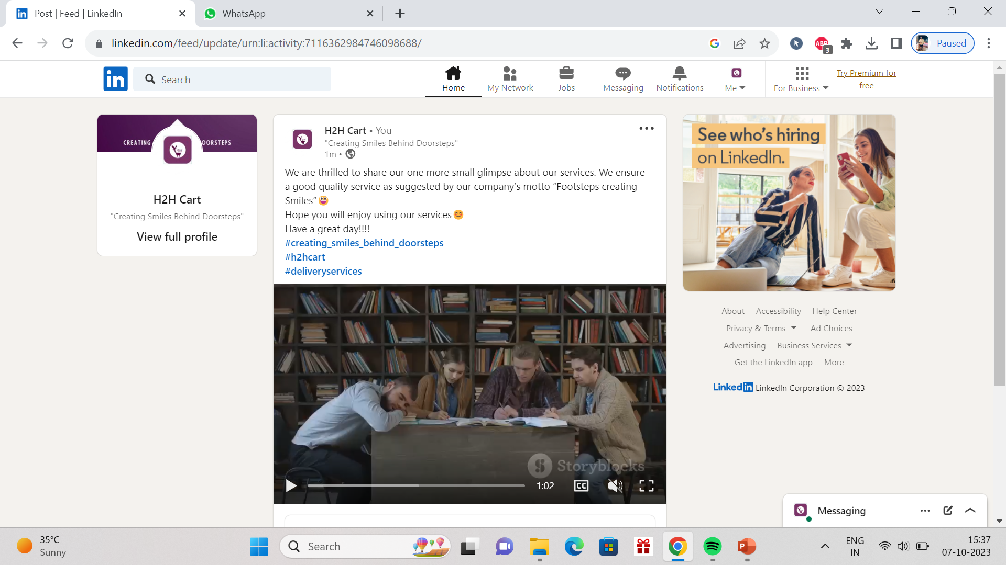

Slide 14
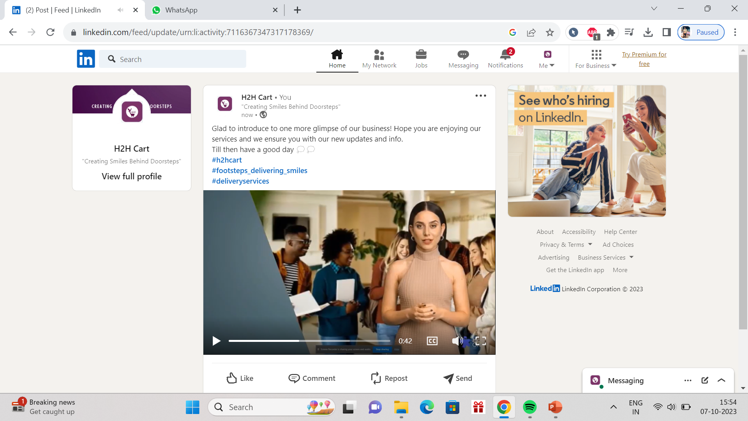

Slide 15
Working Links for LinkedIn Posts
https://www.linkedin.com/posts/h2h-cart-48577a294_h2habrcart-creatingabrsmilesabrbehindabrdoorsteps-activity-7116125055109005312-qIBo?utm_source=share&utm_medium=member_desktop
https://www.linkedin.com/posts/h2h-cart-48577a294_h2habrcart-creatingabrsmilesabrbehindabrdoorsteps-activity-7115961949418385408-_vB-?utm_source=share&utm_medium=member_desktop
https://www.linkedin.com/posts/h2h-cart-48577a294_creatingabrsmilesabrbehindabrdoorsteps-h2hcart-activity-7116362984746098688-HXP4?utm_source=share&utm_medium=member_desktop
https://www.linkedin.com/posts/h2h-cart-48577a294_h2hcart-footstepsabrdeliveringabrsmiles-deliveryservices-activity-7116367347317178369-Vti0?utm_source=share&utm_medium=member_desktop

Slide 16
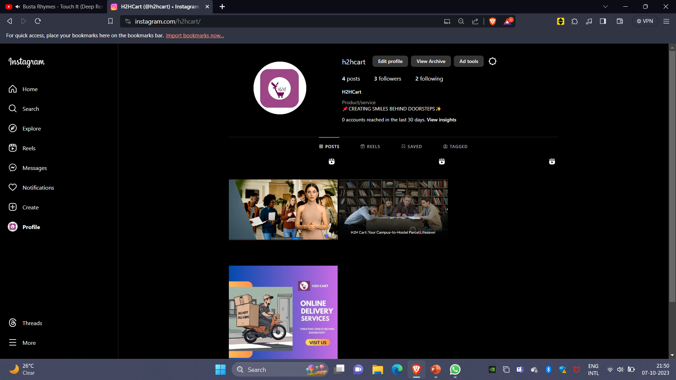
Instagram
Working link of the account:- https://instagram.com/h2hcart?igshid=MzRlODBiNWFlZA==

Slide 17
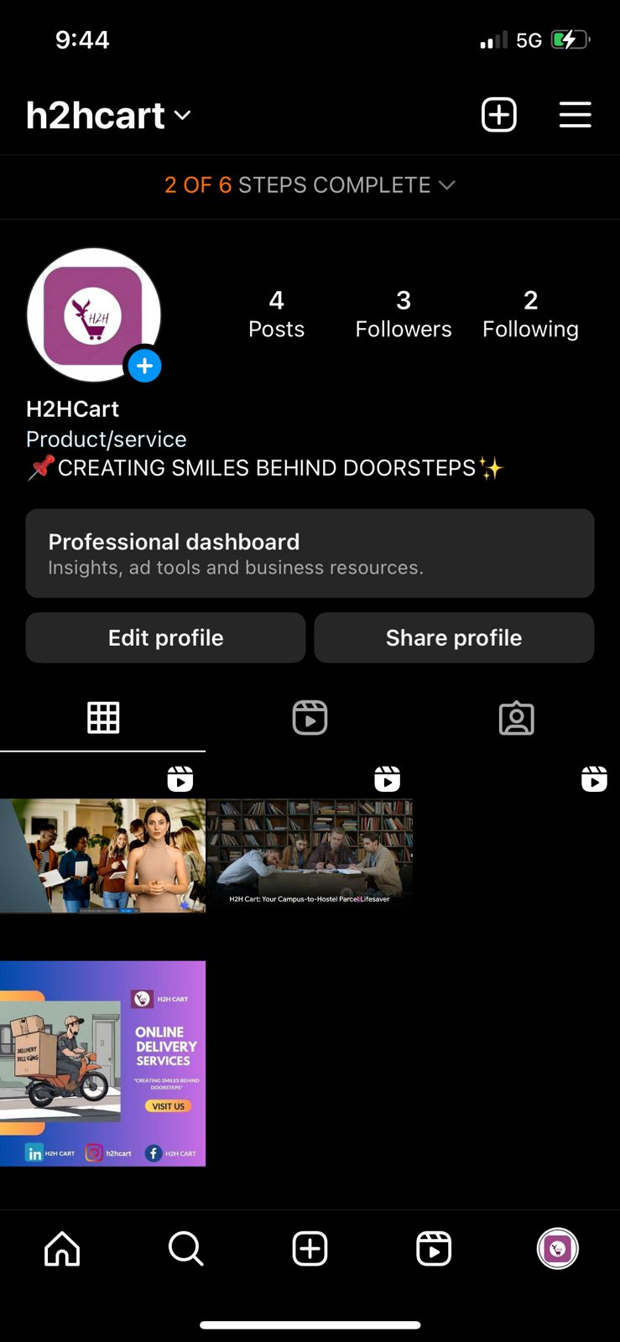

Slide 18
Working Links for Instagram Posts
https://www.instagram.com/reel/CyGpRZpymW_/?igshid=MzRlODBiNWFlZA==
https://www.instagram.com/reel/CyGowwWS4ZY/?igshid=MzRlODBiNWFlZA==
https://www.instagram.com/reel/CyGomKzSdigshid=MzRlODBiNWFlZA==Zh/?
https://www.instagram.com/p/CyGoiH9yYL7/?igshid=MzRlODBiNWFlZA==
https://www.instagram.com/reel/CyIH987SlEZ/?igshid=MzRlODBiNWFlZA==
https://www.instagram.com/reel/CyIIR8_yiXM/?igshid=MzRlODBiNWFlZA==

Slide 19
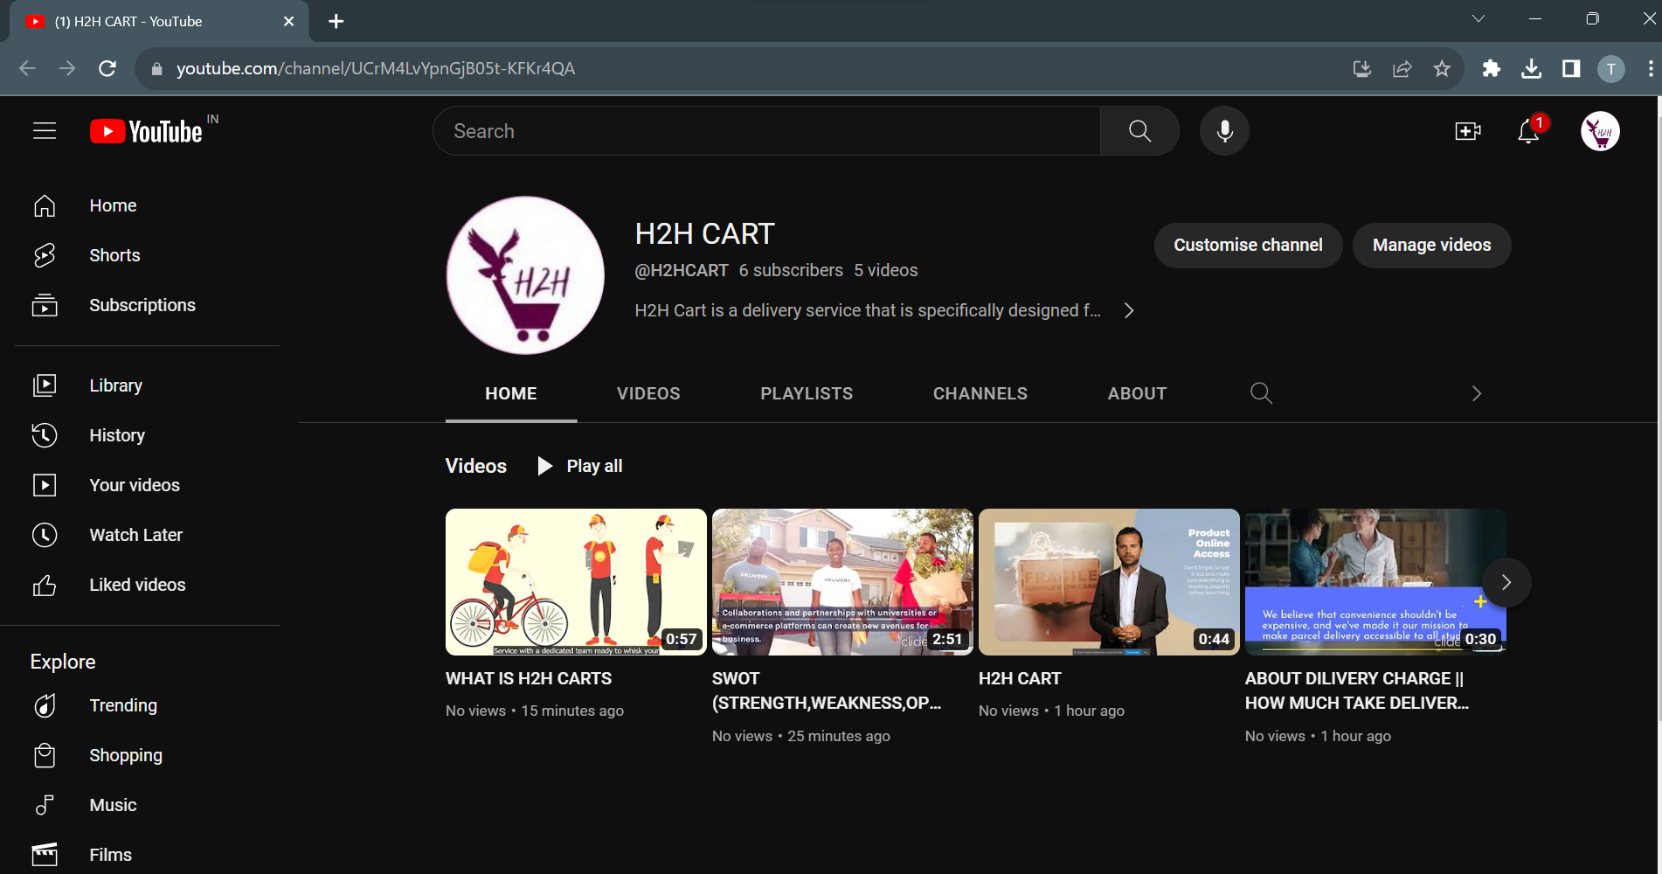
YouTube
Working link of the account:- :- youtube.com/channel/UCrM4LvYpnGjB05t-KFKr4QA

Slide 20
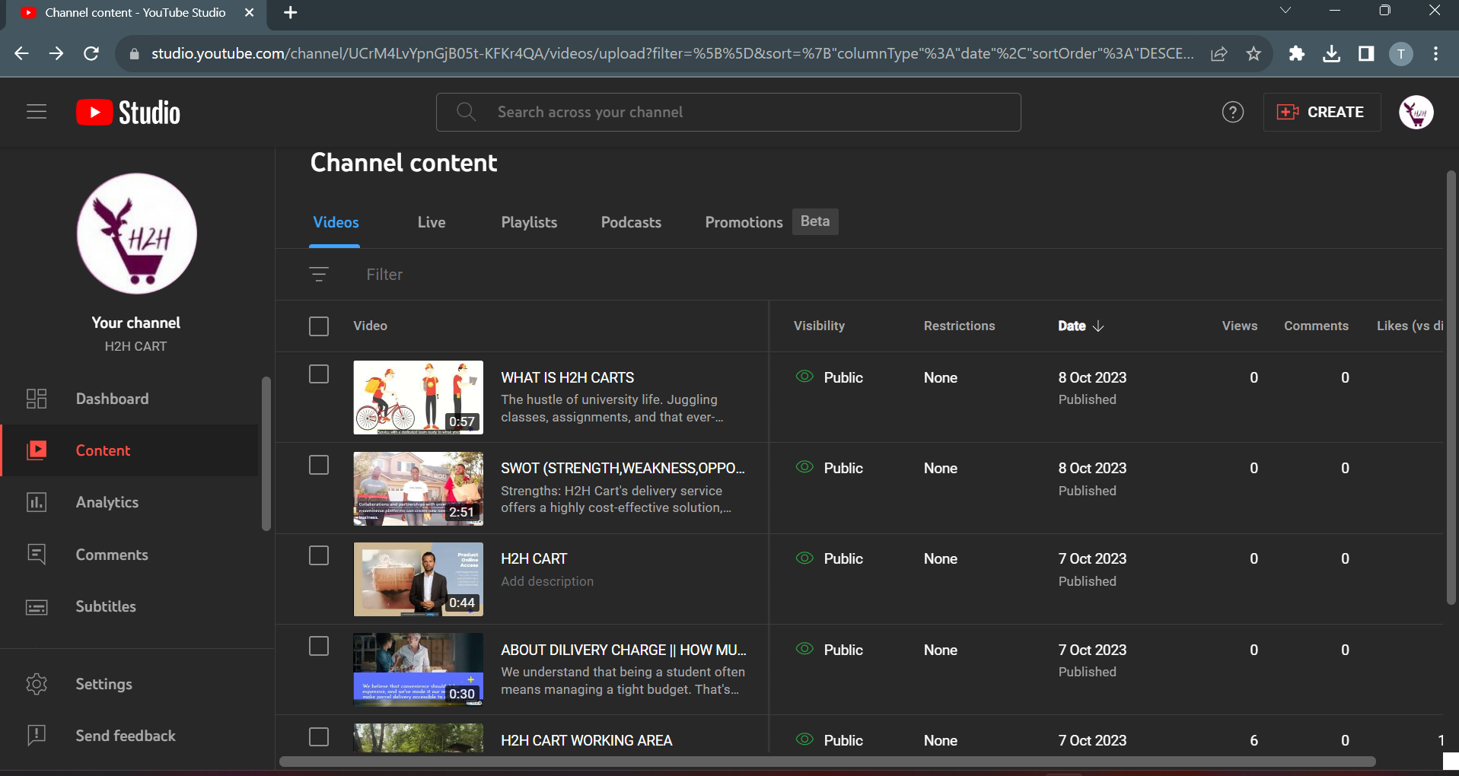

Slide 21
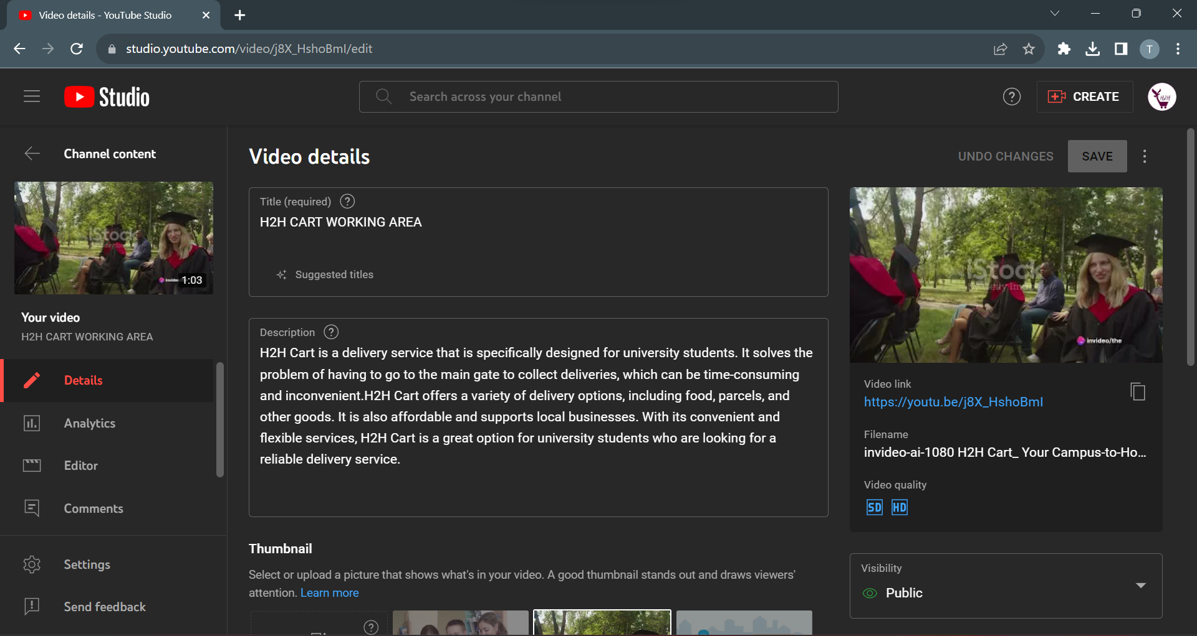

Slide 22
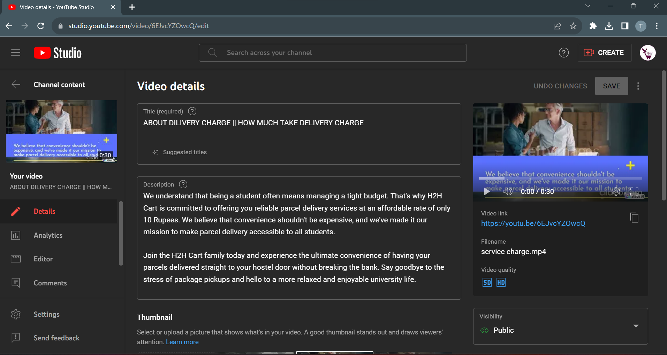

Slide 23
Working Links for YouTube Posts
https://youtu.be/9XHeAh2XcPg?si=2uUlJG7yoaGXw5mk
https://youtu.be/Ga1OMfj2mow?si=29ulaZbnR3sDMETd
https://youtu.be/R4dvLrT4H_A?si=2vnH6XIER4c-etUO
https://youtu.be/6EJvcYZOwcQ?si=N-LDfkMLg3Q1kYrr
https://youtu.be/j8X_HshoBmI?si=_iFRQGLAk0GKVZZw

